Slide 1

Tutorial 01
Course Environment
CIT690E: Deep Learning, Fall22
Aly Abdelmageed

Slide 2
Outline
Contacts and Communication
Online Services for DL Training
Google Colab
Colab vs Colab Pro
Git and GitHub
PyTorch

Slide 3
1. Contacts
Lab Session: after the lecture
Q&A on Teams, or Moodle
Office Hours: room 220 on Tuesday 10:30 to 2:30
Online: confirmation via email
Email: alymohamed@nu.edu.eg

Slide 4

Google Colab
Google colab Cloud-based notebook service hosted by Google, which is equivalent to Jupyter Lab. It enables you write and execute your code on pre-configured machines.
Notebooks
Access to Google Drive
Free GPUs and TPUs
pre-installed packages for DL: PyTorch
You can create a notebook via: https://colab.research.google.com

Slide 5
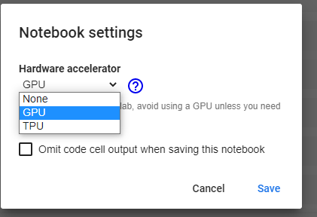
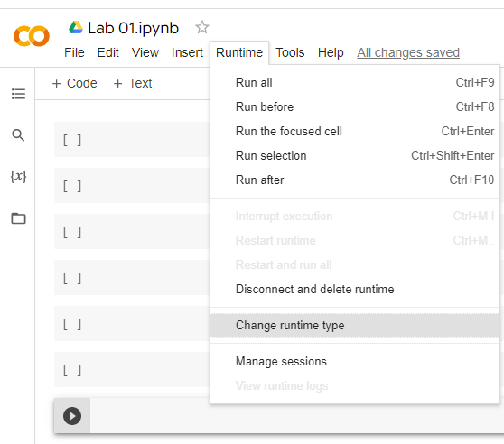
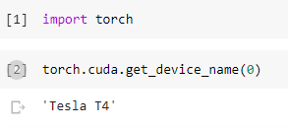
Runtime Environments

Slide 6
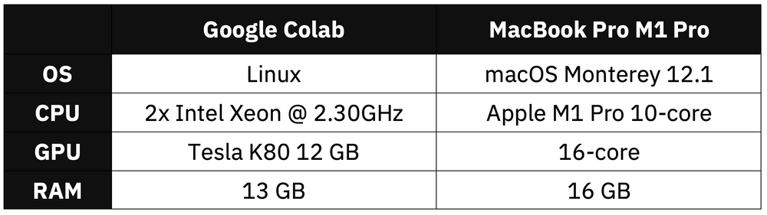
Performance Comparison
As shown in [MacBook M1 Pro vs. Google Colab (Dario Radečić, 2022)], Dogs vs. Cats dataset from Kaggle dataset was used for comparison between training on MacBook and Colab

Slide 7
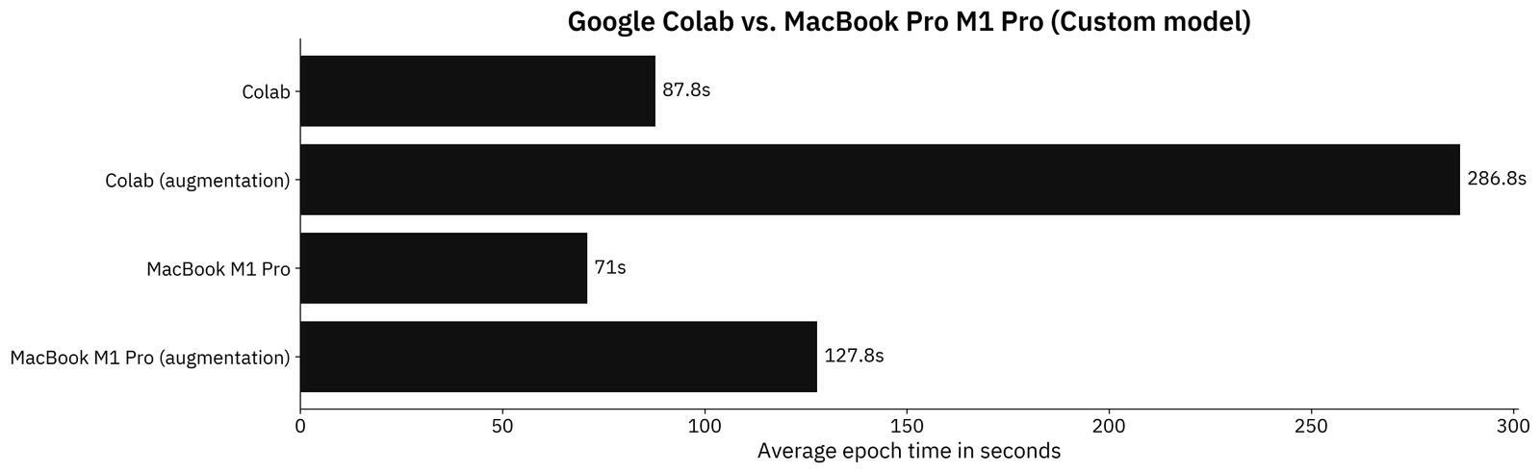
Custom TensorFlow Model

Slide 8
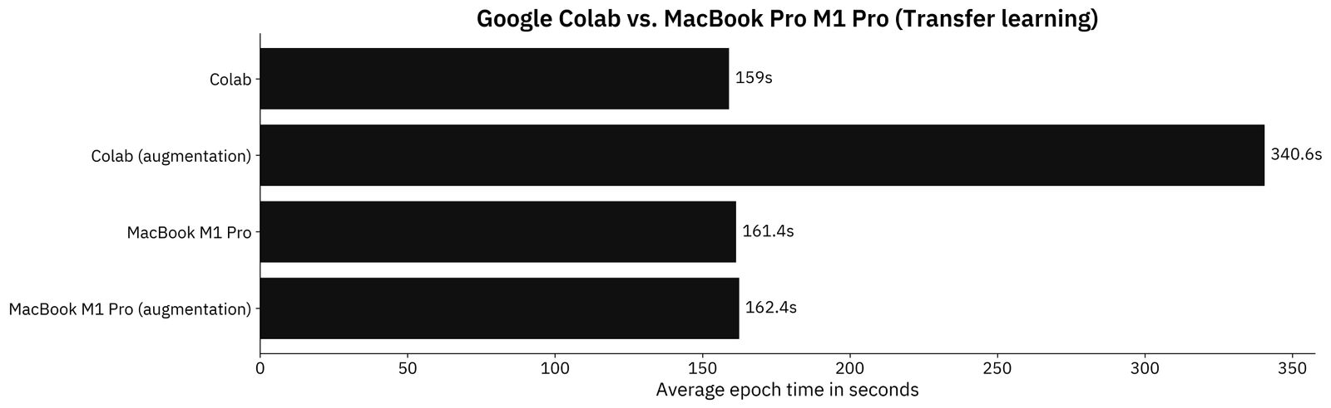
Transfer Learning TensorFlow Model

Slide 9
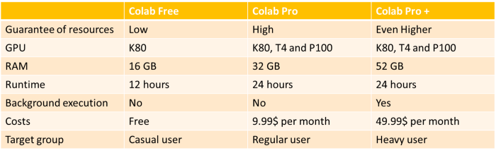
Colab VS. Colab Pro
Google Colab Pro+: Is it worth $49.99? | by Benedikt Droste | Towards Data Science
Google Colab plan

Slide 10
3. Git and GitHub
Git
It is a Version Control system.
It is used for the below cases:
• Synchronization and Collaboration
• Informative Changes Tracking, with messages
• Undo changes, and restoration
• Track Ownership
• Branching and Merging

Slide 11
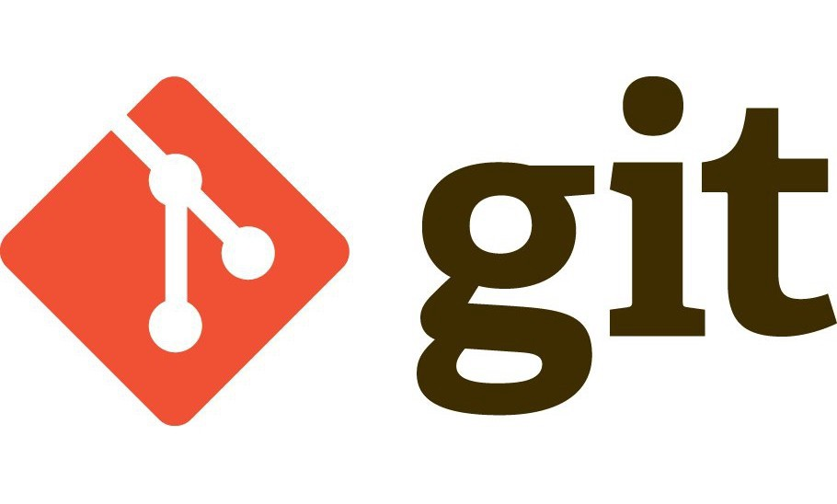

Installing Git
You can install git by visiting the download section:https://git-scm.com/downloads
pickup an installation for your OS. Also, although we are introducing some of the basics of git
below, you are highly encouraged to check the free Pro Git book by Scott Chacon: https://git-scm.com/book/en/v2

Slide 12

Git & GitHub & GitLab
Git:
It is a Version Control system. Therefore, as we see, git is a tool used on our local machines
to communicate with local and remote repositories.
GitHub & GitLab:
A cloud-based hosting platforms for repositories, remote.

Slide 13
Git Commands
• init: initialize a git repository
• add: add file(s) to file index
• status: check status of the current working tree
• commit: save snapshot as entry in history
• push: push the changes to remote repository
• pull: pull changes from remote repository
• clone: clone a remote repository

Slide 14
Further Resources
https://git-scm.com/docs, the official documentation of git
https://docs.github.com/en, the official documentation of GitHub
https://training.github.com/downloads/github-git-cheat-sheet.pdf, cheat sheet for git while using GitHub.

Slide 15
4. PyTorch
open-source Deep Learning library by Facebook
optimized for GPU and CPU
Other products built upon it: Tesla Autopilot, Uber’s Pyro, Hugging
Face’s Transformers, PyTorch Lightning, and Catalyst.
Primary data type: Tensors
CIT690E-Deep Learning Fall22

Slide 16
Thank You!

